Slide 1

Operating Systems
ADITYA COLLEGE OF ENGINEERING &
TECHNOLOGY
Unit-3
(MEMORY MANAGEMENT & VIRTUAL MEMORY)

Slide 2
Contents
Aditya College of Engineering &
Technology
Static and dynamic memory allocation
Basic concepts for memory management
logical and physical addresses
MMU
Base and Limit Registers
Hardware Support for Relocation and Limit Registers
Swapping
Memory Allocation
Contiguous memory allocation
Non-contiguous memory allocation

Slide 3
Aditya College of Engineering &
Technology
Contiguous memory allocation
Fixed memory partitioning
variable memory partitioning
fragmentation
Memory partition selection techniques:
First-fit
best-fit
worst fit
Non-contiguous memory allocation
Paging concept
Paging implementation with associative cache memory
Page table and its structures
Segmentation concept
Hardware requirements for segmentation
Internal fragmentation
External fragmentation

Slide 4
Aditya College of Engineering &
Technology
Virtual Memory
Demand Paging
Page Replacement Algorithms
FIFO(First-In First-Out) Page Replacement
LRU(Least Recently Used) Page Replacement
Optimal Page Replacement
Thrashing
Working Set Model

Slide 5
Static and dynamic memory allocation
Aditya College of Engineering &
Technology
In static allocation, the allocation is done before the execution of the process.
If the memory allocation is deferred till the process starts executing, it is known as dynamic allocation.

Slide 6
Aditya College of Engineering &
Technology
Binding of Instructions and Data to Memory
Address binding of instructions and data to memory addresses can happen at three different stages.
Compile time: If memory location known a priori, absolute code can be generated; must recompile code if starting location changes.
Load time: Must generate relocatable code if memory location is not known at compile time.
Execution time: Binding delayed until run time if the process can be moved during its execution from one memory segment to another. Need hardware support for address maps (e.g., base and limit registers).

Slide 7
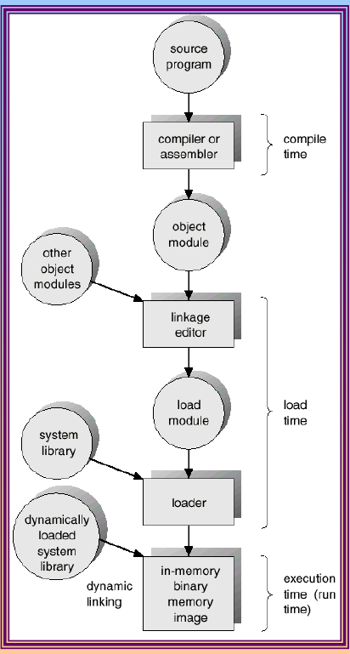
Aditya College of Engineering &
Technology
Multistep Processing of a User Program
Process1---100KB
14240--14340
PAS=LAS+contents of relocation register
=100+14240
=14340

Slide 8
Aditya College of Engineering &
Technology
Logical and physical addresses
The processor at compile time generates some addresses known as logical addresses.
The set of all logical addresses generated by the compilation of the process is known as logical address space.
Logical address is generated by the CPU also referred to as virtual address.
Logical addresses need to be converted into absolute addresses at the time of execution of the process. These absolute addresses are known as physical addresses.
The set of physical addresses generated corresponding to all logical addresses during process execution is known as physical address space.
Logical and physical addresses are the same in compile-time and load-time address-binding schemes
logical (virtual) and physical addresses differ in execution-time address-binding scheme.

Slide 9
Memory-Management Unit (MMU)
Aditya College of Engineering &
Technology
Hardware device that maps virtual to physical address.
In MMU scheme, the value in the relocation register(Base register) is added to every address generated by a user process at the time it is sent to memory.
The user program deals with logical addresses; it never sees the real physical addresses.
Physical Address Space = Logical Address Space + Contents of Base Register
(relocation register)

Slide 10
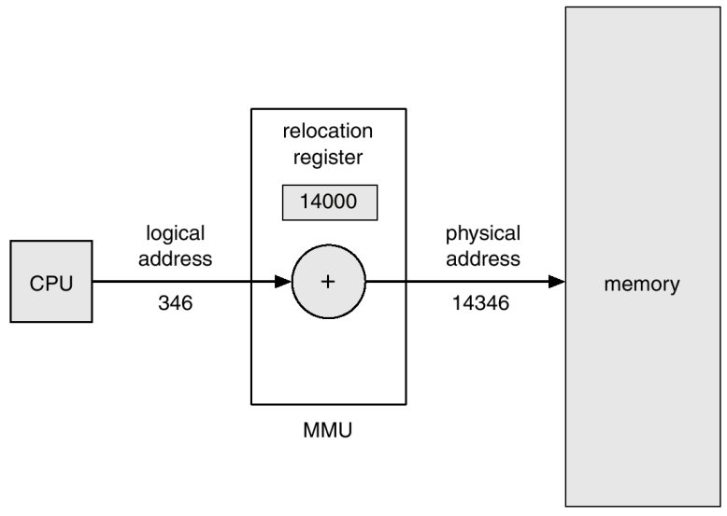
Aditya College of Engineering &
Technology
Dynamic relocation using a relocation register

Slide 11
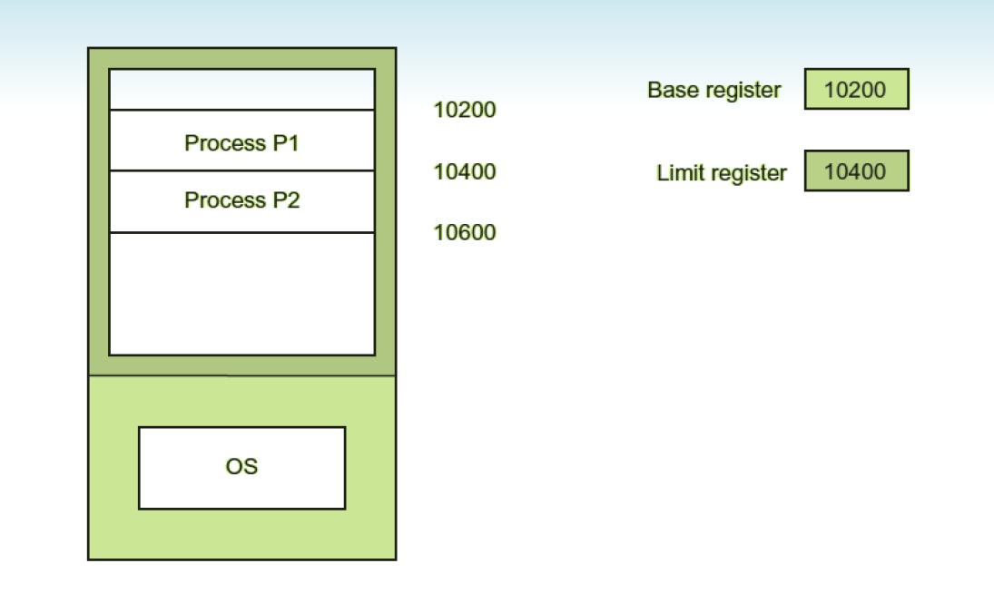
Base and Limit Registers
Aditya College of Engineering &
Technology
Relocation register Starting location of the memory in which
the user process is to be stored
limit register contains range of logical addresses
Each logical address must be less than the limit register.

Slide 12
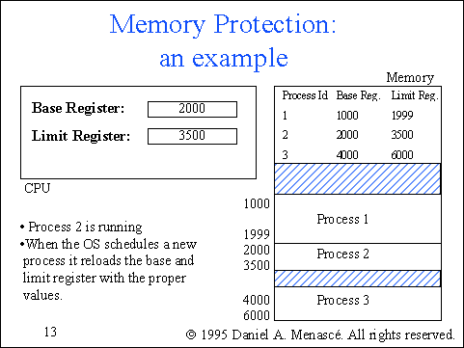
Aditya College of Engineering &
Technology

Slide 13
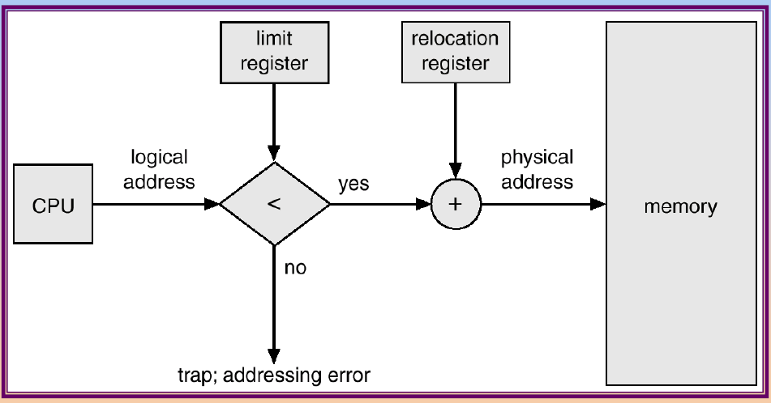
Hardware Support for Relocation and Limit Registers
Aditya College of Engineering &
Technology
Relocation register Starting location of the memory in which
the user process is to be stored.
limit register contains range of logical addresses.
Each logical address must be less than the limit register.

Slide 14
Swapping
Aditya College of Engineering &
Technology
A process needs to be in memory for execution. But sometimes there is not enough main memory to hold all the currently active processes in a timesharing system.
So, excess process are kept on disk and brought in to run dynamically.
Swapping is the process of bringing in each process in main memory, running it for a while and then put it back to the disk.
A process can be swapped temporarily out of memory to a backing store, and then brought back into memory for continued execution.
Backing store(Hard Disk) – fast disk large enough to accommodate copies of all memory images for all users; must provide direct access to these memory images.
The action of taking out a process from the memory is called swap -out and the processes are known as swapped-out processes.
When the swapped-out process is brought again in the memory, it is called as swap-in. The separate space in hard disk known as swap space is reserved for the swapped-out processes.

Slide 15
Factors to be considered during swapping?
Aditya College of Engineering &
Technology
Where will this process reside?----harddisk (backing store)—swap space
Which process will be taken out?---low priority process or process whose time slice expires,waiting for i/o etc…
Where in the memory will the process be brought back?----based on binding----same or different location

Slide 16
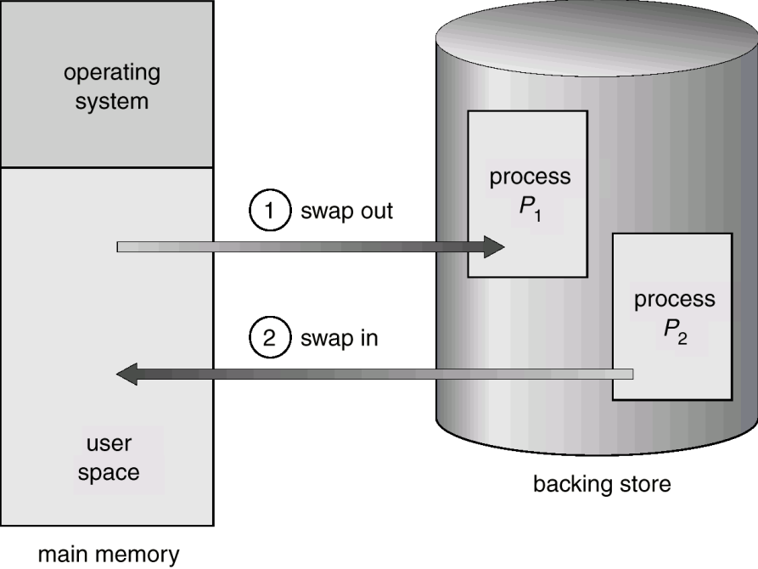
Schematic View of Swapping
Aditya College of Engineering &
Technology

Slide 17
Aditya College of Engineering &
Technology
Memory Allocation
Main memory usually into two partitions:
Resident operating system, usually held in low memory
User processes held in high memory.
Single-partition allocation
Relocation-register scheme used to protect user processes from each other, and from changing operating-system code and data.
Multiple-partition allocation
Hole – block of available memory; holes of various size are scattered throughout memory. When a process arrives, it is allocated memory from a hole large enough to accommodate it.
Operating system maintains information about:
a) allocated partitions
b) free partitions (hole)

Slide 18
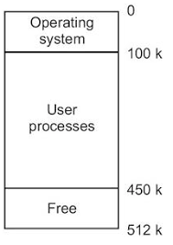
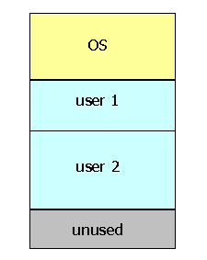
Aditya College of Engineering &
Technology
Single-partition allocation
Multiple-partition allocation

Slide 19
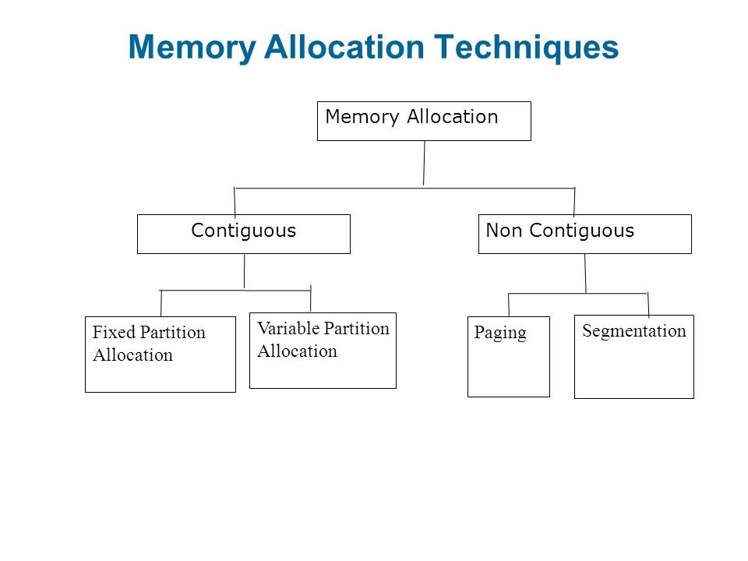
Aditya College of Engineering &
Technology

Slide 20
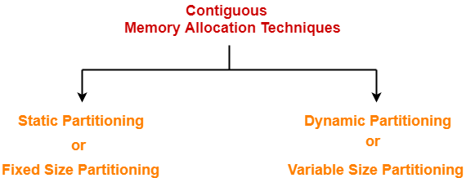
Contiguous Allocation
Aditya College of Engineering &
Technology
The contiguous allocation method was implemented by partitioning the memory into various regions.
The memory partition which is free to allocate is known as a hole.
Thus an appropriate hole is searched for allocating memory to a process.

Slide 21
Contiguous Allocation with fixed partitioning
Aditya College of Engineering &
Technology
Fixed partitioning is the method of partitioning the memory at the time of system generation.
The partition size can be of fixed as well as variable but once fixed cannot be changed.
Partition Description Table
Partition ID | Starting Address | size | Allocation status
1 | 100 | 350 | allocated
2 | 450 | 200 | allocated
3 | 650 | 300 | free
4 | 950 | 100 | free

Slide 22
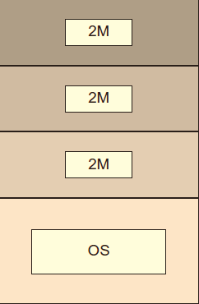
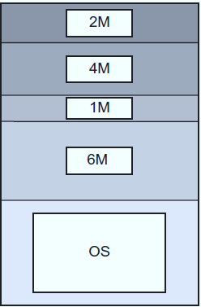
Contiguous Allocation with fixed partitioning
Aditya College of Engineering &
Technology
Fixed equal sized partitioning
based contiguous memory allocation
Fixed unequal sized partitioning
based contiguous memory allocation

Slide 23
Contiguous Allocation with Dynamic/variable Partitioning
Aditya College of Engineering &
Technology
Instead of having static partitions in the memory the memory partition will be allocated to a process dynamically.
As the processes dynamically occupy and release the memory, a time is reached when there are small holes generated in the memory partitions. These memory partitions at a certain time cause the external fragmentation.

Slide 24
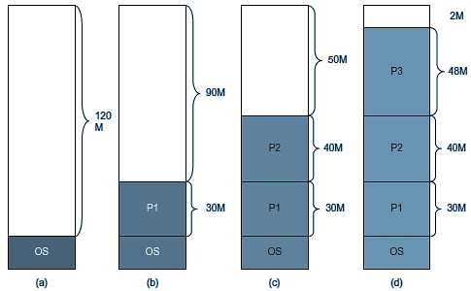
Variable Partitioning
Aditya College of Engineering &
Technology

Slide 25
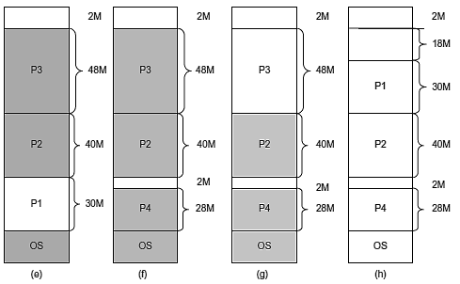
Variable Partitioning
Aditya College of Engineering &
Technology

Slide 26
Fragmentation
Aditya College of Engineering &
Technology
External Fragmentation – total memory space exists to satisfy a request, but it is not contiguous.
Internal Fragmentation – allocated memory may be slightly larger than requested memory; this size difference is memory internal to a partition, but not being used.
Reduce external fragmentation by compaction.

Slide 27
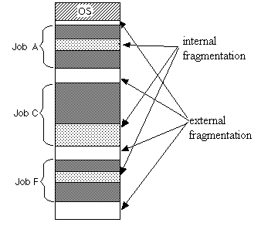
Aditya College of Engineering &
Technology

Slide 28
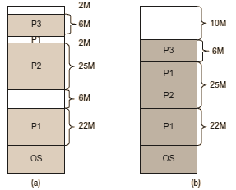
Compaction
Aditya College of Engineering &
Technology
Compaction is the solution for memory wastage occurred in dynamic partitioning.
The operating system observes the number of holes in the memory and compacts them after a period so that a contiguous memory can be allocated for a new process.
Before compaction
After compaction

Slide 29
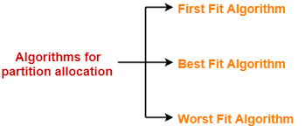
Memory partition selection techniques
Aditya College of Engineering &
Technology
Memory allocation techniques are the algorithms that satisfy the memory needs of a process of size n out of the list of available free holes thereby known as partition selection algorithms.
Allocate first hole which is big enough
Allocates best hole(smallest) hole
Allocate largest hole which is big enough

Slide 30
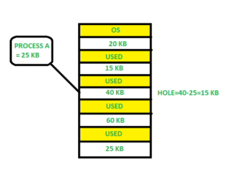
First Fit
Aditya College of Engineering &
Technology
The first hole that is big enough is allocated to program.
In the first fit, the partition is allocated which is first sufficient block from the top of Main Memory.
It scans memory from beginning and chooses the first available block that is large enough . Thus it allocate the first hole that is large enough.

Slide 31
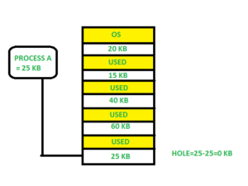
Aditya College of Engineering &
Technology
Best Fit
The smallest hole that is big enough is allocated to program.
Allocate the process to the partition which is the first smallest sufficient partition among the free available partition.
It search the entire list of holes to find the smallest hole whose size is greater than or equal to size of process.

Slide 32
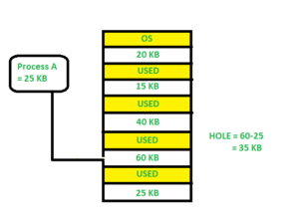
Worst Fit
Aditya College of Engineering &
Technology
The largest hole that is big enough is allocated to program.
Allocate the process to the partition which is the largest sufficient among the freely available partitions available in the main memory.
It is opposite to the best fit algorithm.
It search the entire list of hole to find the largest hole and allocate it to process.

Slide 33
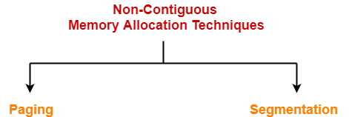
Non-contiguous memory allocation
Aditya College of Engineering &
Technology
Contiguous allocation method either in memory or in backing store wastes much of the memory.
It leads not to have contiguous allocation but non-contiguous method, i.e. instead of having sufficient contiguous memory space it should be possible to allocate the space in memory wherever the holes are available. The holes need not to be contiguous.

Slide 34
Paging
Aditya College of Engineering &
Technology
Main Memory is equal-sized partitioned, partitions are known as frames.
The logical memory of a process is also divided into small fixed-size chunks or blocks of the same size as of frames. These chunks of processes are called pages of the process.
The hard disk is also divided into the blocks which are of same size as frames.
Thus, paging is a logical concept that divides the logical address space of a process into fixed sized partitions known as pages and is implemented in physical memory through the frames.
Instead of a base register for every page, the start addresses of pages are stored in the form of a table known as page table.

Slide 35
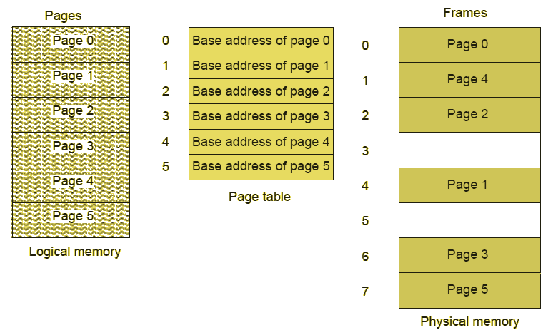
Paging
Aditya College of Engineering &
Technology

Slide 36
Paging
Aditya College of Engineering &
Technology
Paging generates the logical address in the form:
(Page number p, Offset d)
The logical address is converted into physical address by the memory management unit.
The hardware support needed in this case is to have a register just like the base register so that the page table address can be stored. This base register is now known as page table base register (PTBR).
some of the page table entries are cached in a high speed cache memory. A high speed associative cache memory known as translation look aside buffer (TLB) is used for this purpose.

Slide 37
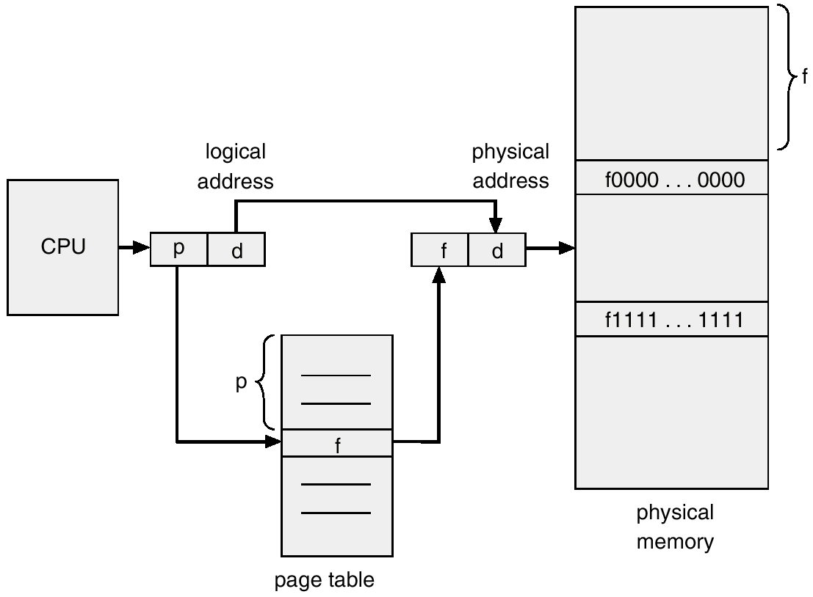
Address translation in Paging
Aditya College of Engineering &
Technology

Slide 38
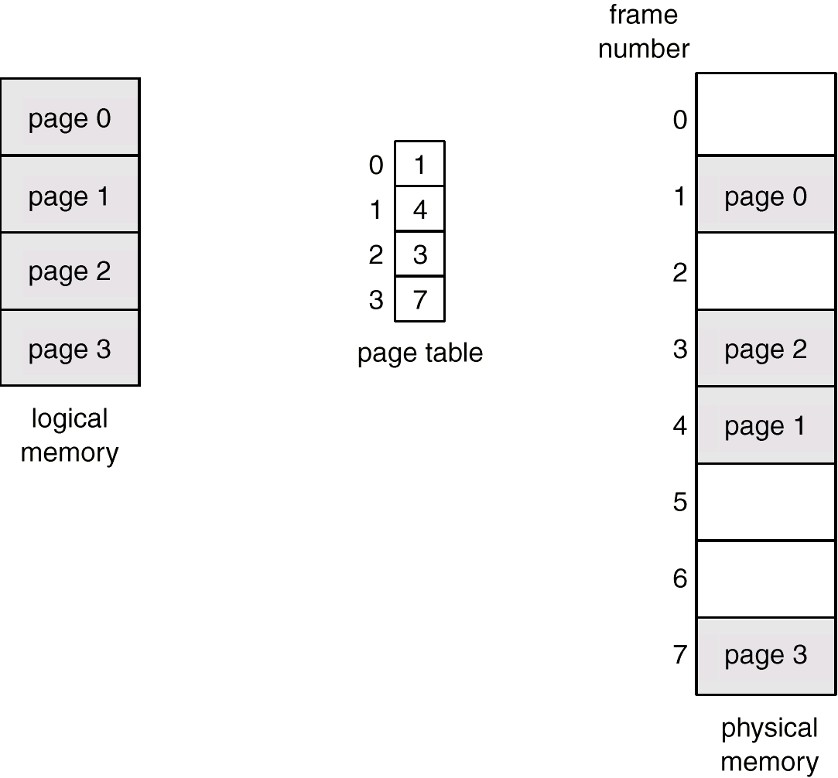
Aditya College of Engineering &
Technology
Paging Example

Slide 39
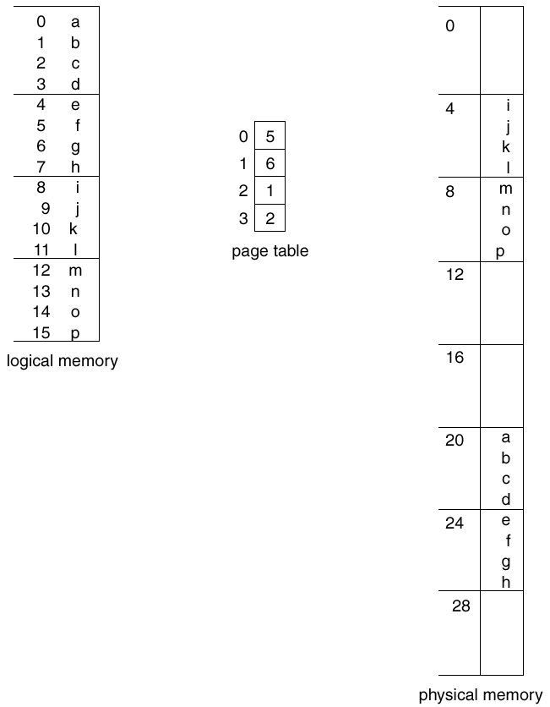
Aditya College of Engineering &
Technology
Paging Example
Page 0
Frame 0
Page 1
Frame 1
Page 2
Frame 2
Page 3
Frame 3
Frame 4
Frame 5
Frame 6
Frame 7
32 bytes

Slide 40
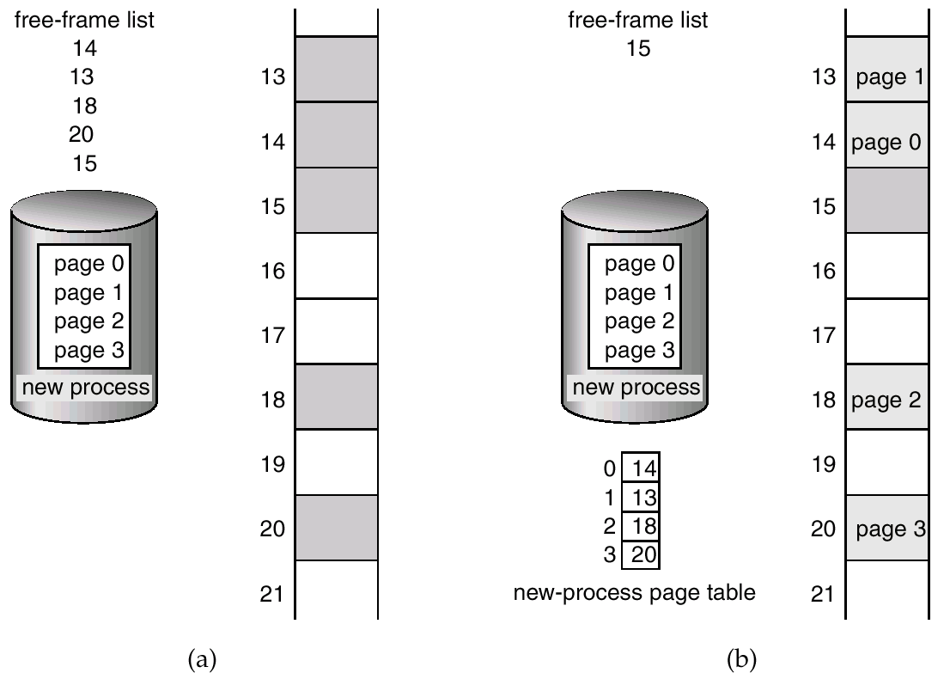
Free Frames
Aditya College of Engineering &
Technology

Slide 41
Implementation of Page Table
Aditya College of Engineering &
Technology
Page table is kept in main memory.
Page-table base register (PTBR) points to the page table.
Page-table length register (PTLR) indicates size of the page table.
In this scheme every data/instruction access requires two memory accesses. One for the page table and one for the data/instruction.
The two memory access problem can be solved by the use of a special fast-lookup hardware cache called associative memory or translation look-aside buffers (TLBs)

Slide 42
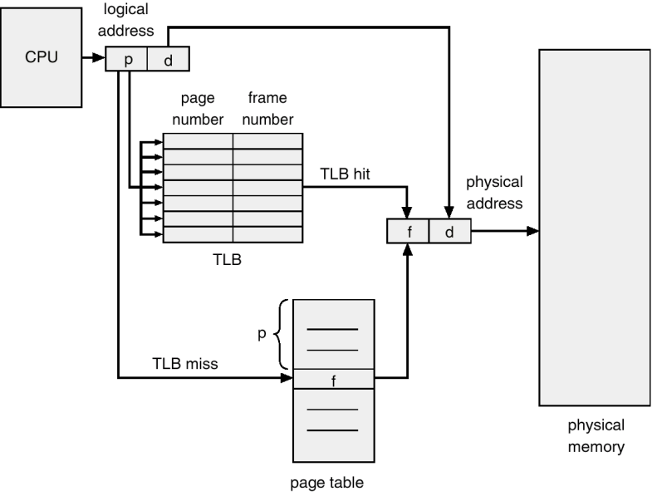
Paging Hardware with TLB
Aditya College of Engineering &
Technology

Slide 43
Memory Protection in paging
Aditya College of Engineering &
Technology
Memory protection implemented by associating protection bit with each frame.
Valid-invalidbit attached to each entry in the page table:
“valid” indicates that the associated page is in the process’ logical address space, and is thus a legal page.
“invalid” indicates that the page is not in the process’ logical address space

Slide 44
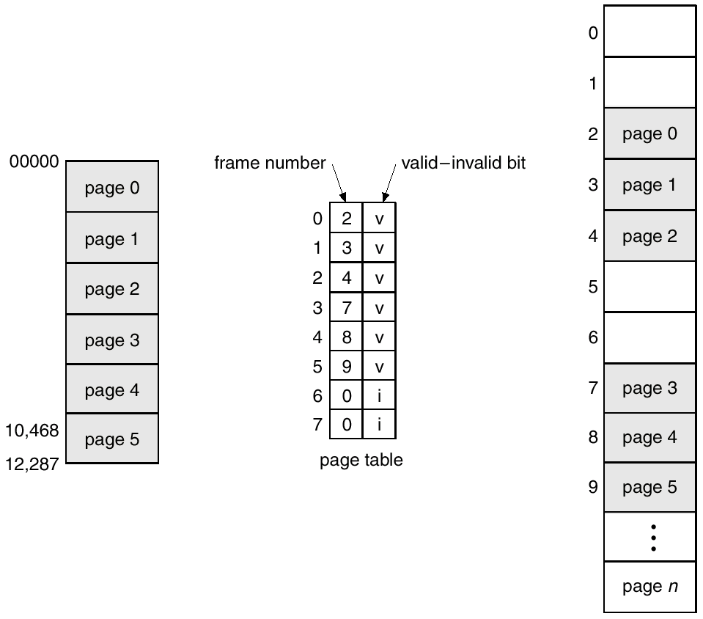
Valid (v) or Invalid (i) Bit In A Page Table
Aditya College of Engineering &
Technology

Slide 45
Shared Pages
Aditya College of Engineering &
Technology
Shared code
One copy of read-only (re-entrant) code shared among processes (i.e., text editors, compilers, window systems).
Shared code must appear in same location in the logical address space of all processes.
Private code and data
Each process keeps a separate copy of the code and data.
The pages for the private code and data can appear anywhere in the logical address space.

Slide 46
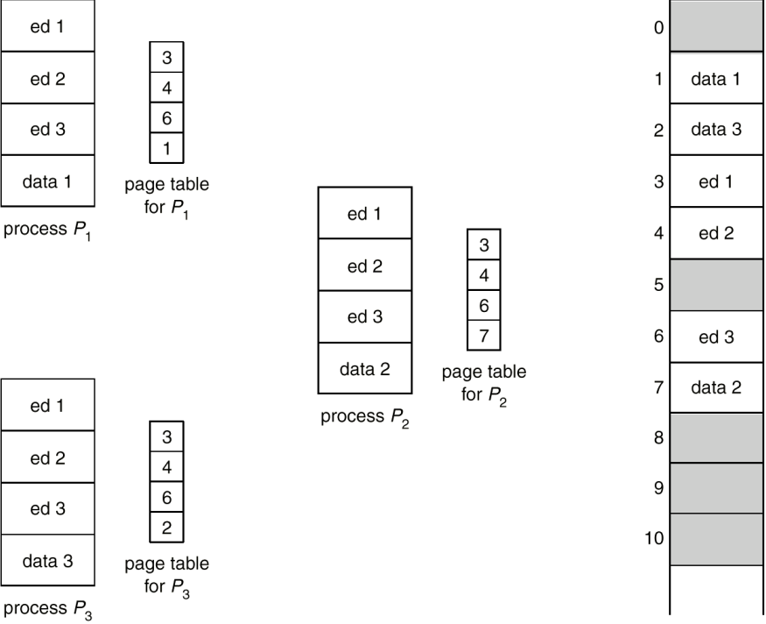
Shared Pages Example
Aditya College of Engineering &
Technology

Slide 47
Page Table Structure
Aditya College of Engineering &
Technology
Hierarchical Page tables
Hashed Page Tables
Inverted Page Tables

Slide 48
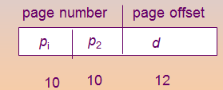
Hierarchical Page Tables
Aditya College of Engineering &
Technology
Break up the logical address space into multiple page tables.
A simple technique is a two-level page table.
Example: A logical address (on 32-bit machine with 4K page size) is divided into:
a page number consisting of 20 bits.
a page offset consisting of 12 bits.
Since the page table is paged, the page number is further divided into:
a 10-bit page number.
a 10-bit page offset.
Thus, a logical address is as follows:
where p is an index into the outer page table, and p is the displacement within the page of the outer page table.

Slide 49
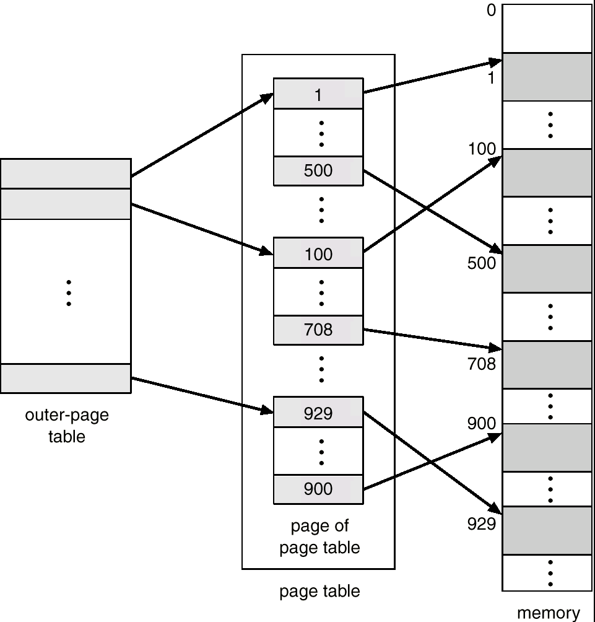
Two-Level Page-Table Scheme
Aditya College of Engineering &
Technology

Slide 50
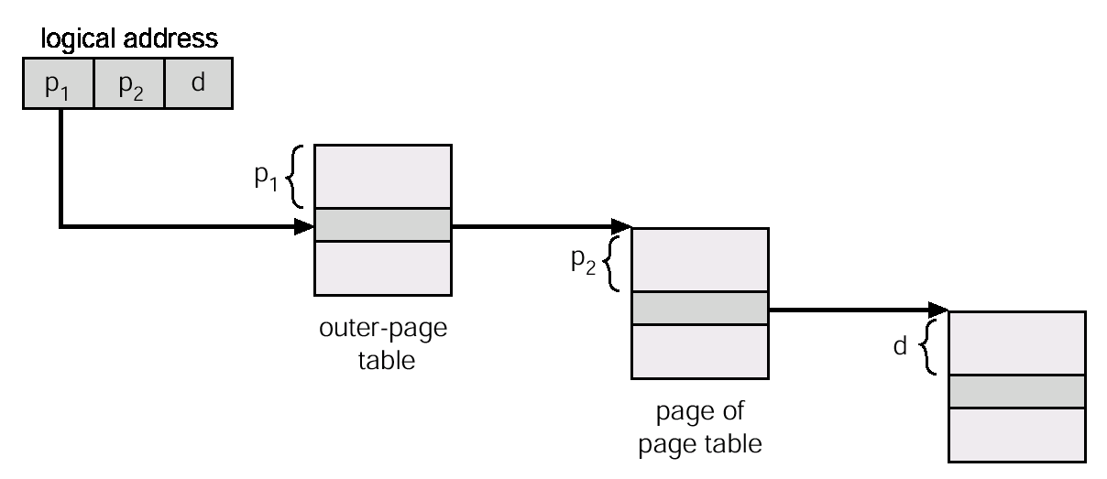
Address-Translation Scheme
Aditya College of Engineering &
Technology
Address-translation scheme for a two-level 32-bit paging architecture

Slide 51
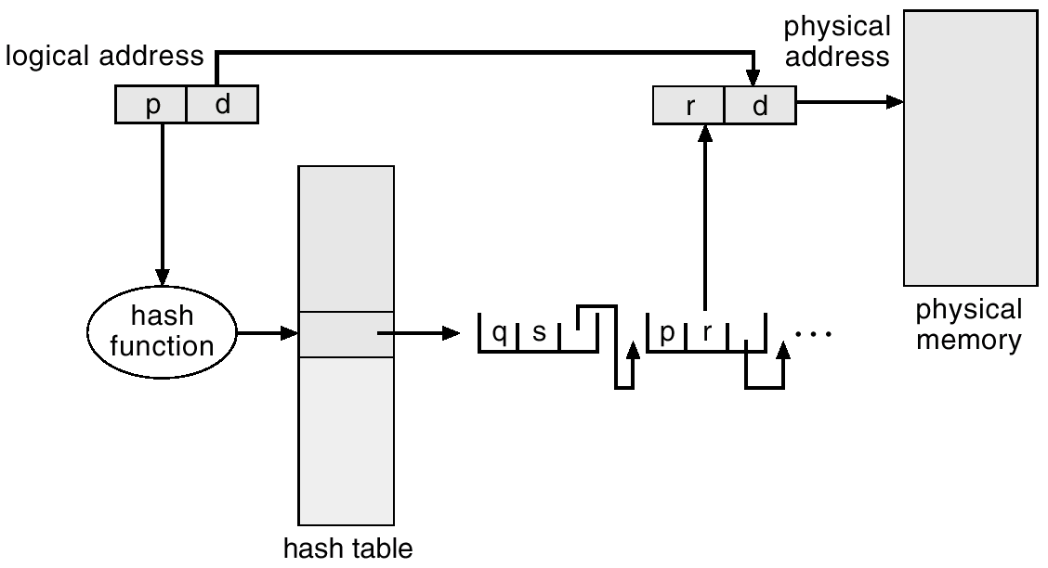
Hashed Page Tables
Aditya College of Engineering &
Technology
Common in address spaces > 32 bits.
The virtual page number is hashed into a page table.
This page table contains a chain of elements hashing to the same location.
Virtual page numbers are compared in this chain searching for a match.
If a match is found, the corresponding physical frame is extracted

Slide 52
Inverted Page Tables
Aditya College of Engineering &
Technology
One entry for each real page of memory.
Entry consists of the virtual address of the page stored in that real memory location, with information about the process that owns that page.
Decreases memory needed to store each page table, but increases time needed to search the table when a page reference occurs.
Use hash table to limit the search to one — or at most a few — page-table entries

Slide 53
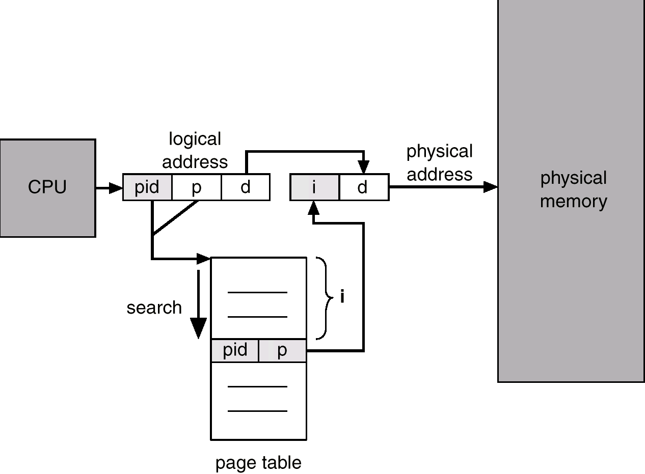
Inverted Page Tables
Aditya College of Engineering &
Technology

Slide 54
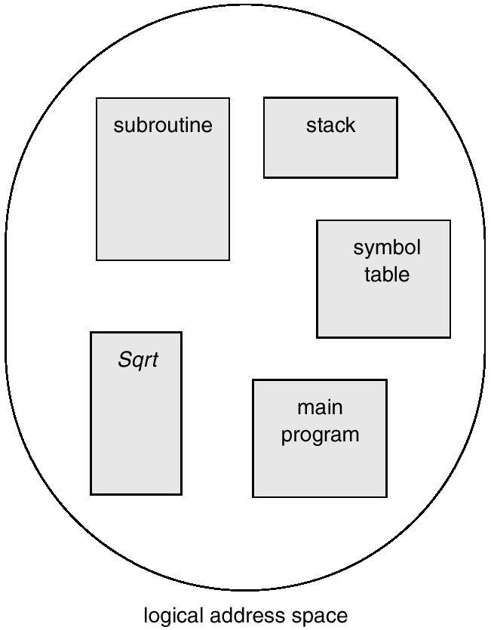
Segmentation
Aditya College of Engineering &
Technology
Memory-management scheme that supports user view of memory.
A program is a collection of segments.
Logical address space is divided into variable sized segments.
A segment is a logical unit such as:
main program,
procedure,
function,
method,
object,
local variables,
global variables,
common block,
stack,
symbol table,
arrays

Slide 55
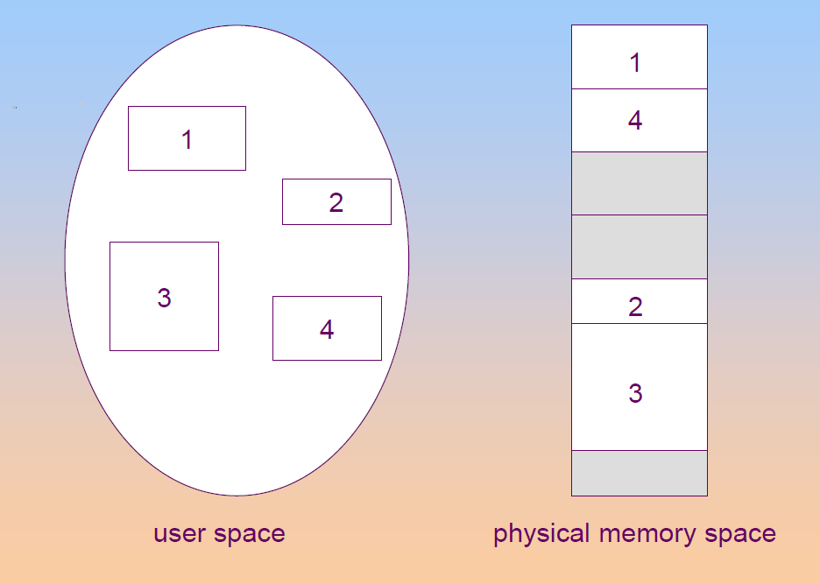
Logical View of a Segmentation
Aditya College of Engineering &
Technology

Slide 56
Segmentation Architecture
Aditya College of Engineering &
Technology
Logical address consists of a two tuple:
<segment-number, offset>
Segment table – maps two-dimensional physical addresses;
Each table entry has:
base – contains the starting physical address where the segments reside in memory.
limit – specifies the length of the segment.
Segment-table base register (STBR) points to the segment table’s location in memory.
Segment-table length register (STLR) indicates number of segments used by a program; segment number s is legal if s < STLR.

Slide 57
Aditya College of Engineering &
Technology
Relocation.
dynamic
by segment table
Sharing.
shared segments
same segment number
Allocation.
first fit/best fit
external fragmentation
Protection.
With each entry in segment table associate:
validation bit = 0 -> illegal segment
read/write/execute privileges
Protection bits associated with segments;
code sharing occurs at segment level.
Since segments vary in length, memory allocation is a dynamic storage-allocation.

Slide 58
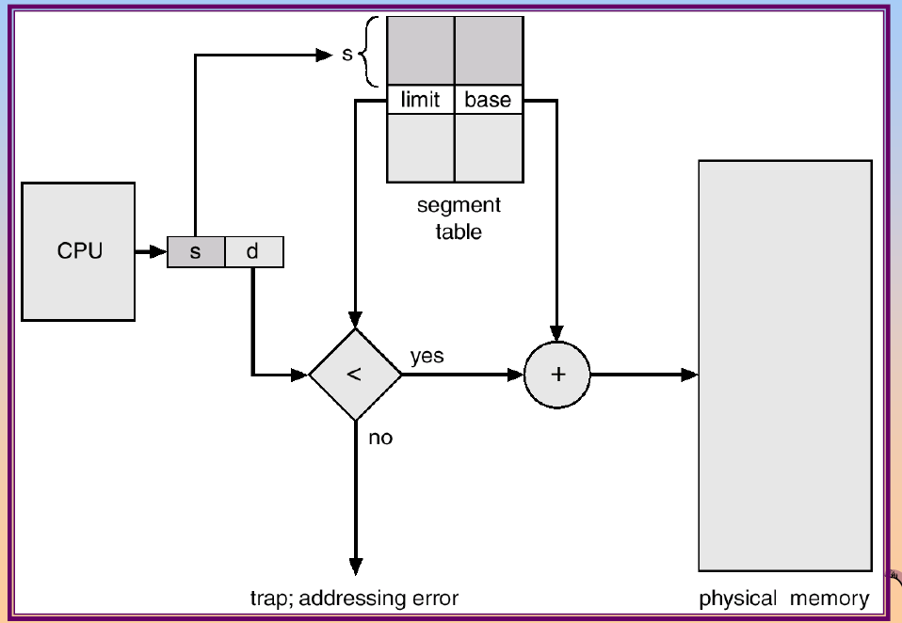
Segmentation Hardware
Aditya College of Engineering &
Technology
700
665

Slide 59
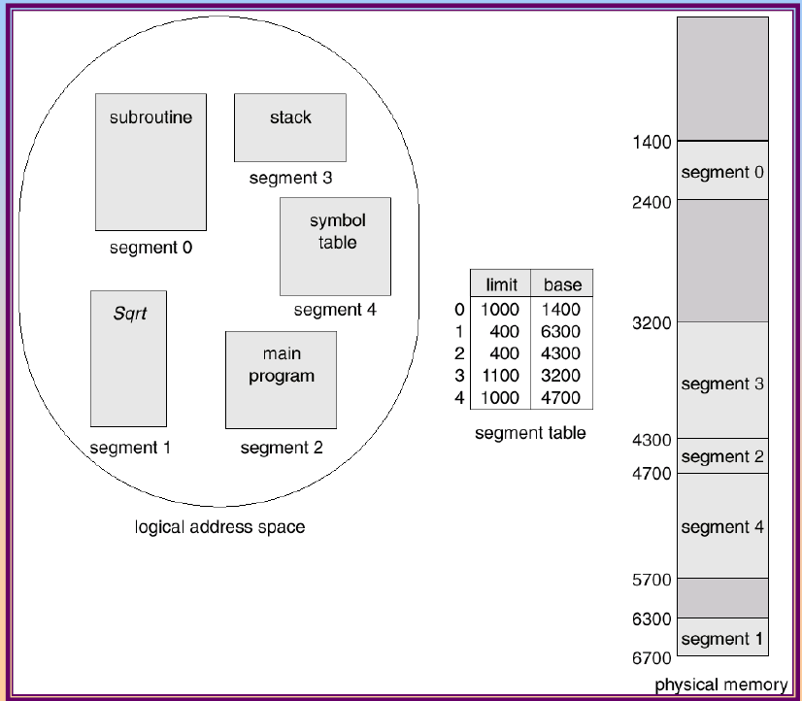
Example of Segmentation
Aditya College of Engineering &
Technology

Slide 60
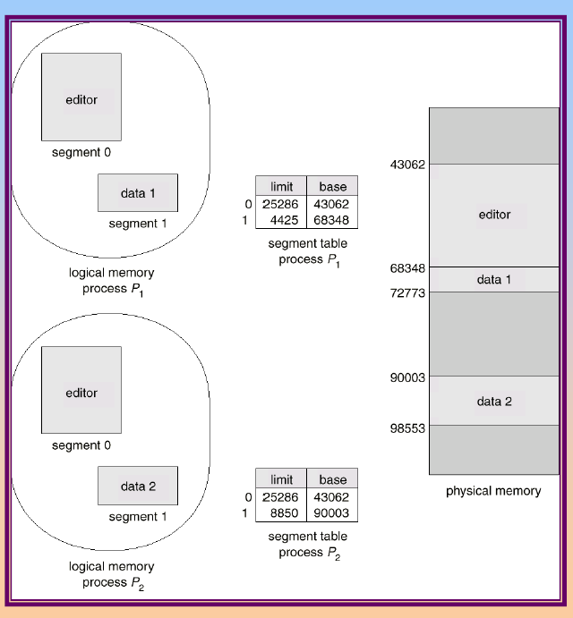
Sharing of Segments
Aditya College of Engineering &
Technology

Slide 61
Example
Aditya College of Engineering &
Technology
Segment number | Length | Base Address
0 | 200 | 4100
1 | 700 | 1000
2 | 400 | 3700
3 | 900 | 1800
4 | 1000 | 2700
Show the physical memory mapping for the segments. what will be the
physical memory address for the following logical addresses
s | d
1 | 665
3 | 906
4 | 770
i) Physical Address=Base address+offset
=1000+665=1665 (665<700)
ii)Invalid address. because 906>900(offset>limit)
iii)PA=2700+770=3470 (770<1000)

Slide 62
Aditya College of Engineering &
Technology
THANK YOU

